Slide 1
STORE SALES FORECASTING

Slide 2
MOTIVATION
ANALYZE
DECISION MAKING
Predict future store sales for informed retail decisions.
Mine data, analyze time series for key sales drivers.
TEAMWORK
PATTERNS
Multivariate analysis unveils store sales influencers.
Sales data has valuable temporal patterns.
FORECASTING
REAL WORLD APPLICATION
Accurate sales forecasting maximizes overall business profitability

Slide 3
Research Question
How can data mining and machine learning models be leveraged to forecast store sales accurately across various time periods using the provided multivariate dataset?
JUPTER
Jupiter is a gas giant and the biggest planet
SATURN
Saturn is composed of hydrogen and helium
NEPTUNE
Venus has a beautiful name and is the second planet
Neptune is the farthest planet from the Sun

Slide 4
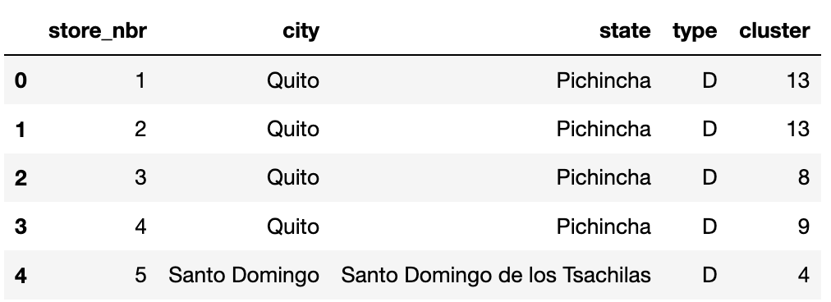
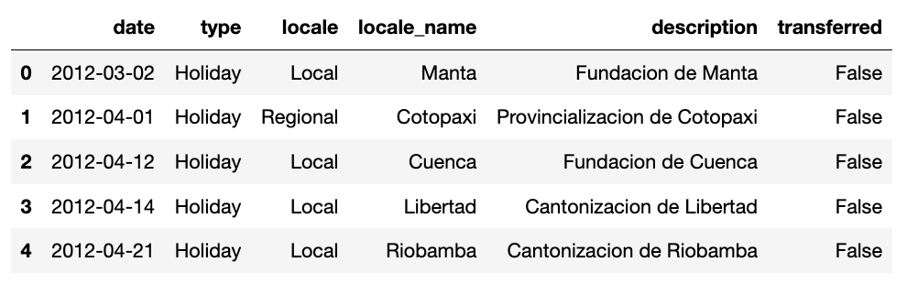
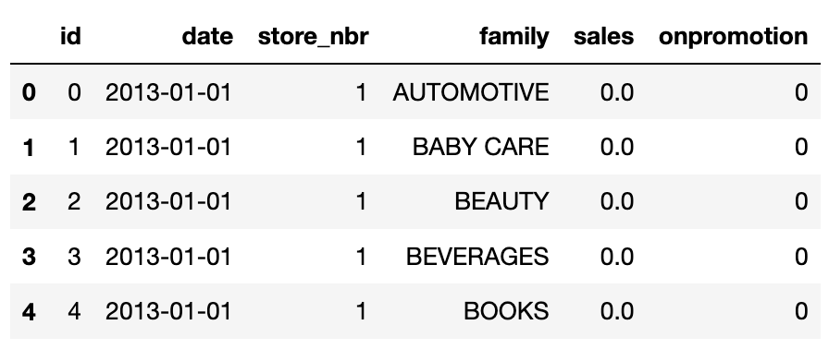
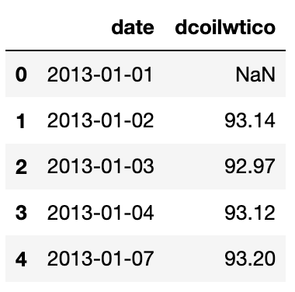
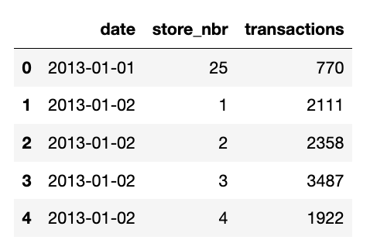
DATA SET
STORE
HOLIDAYS & EVENTS
TRAIN
OIL PRICES
TRANSACTION

Slide 5
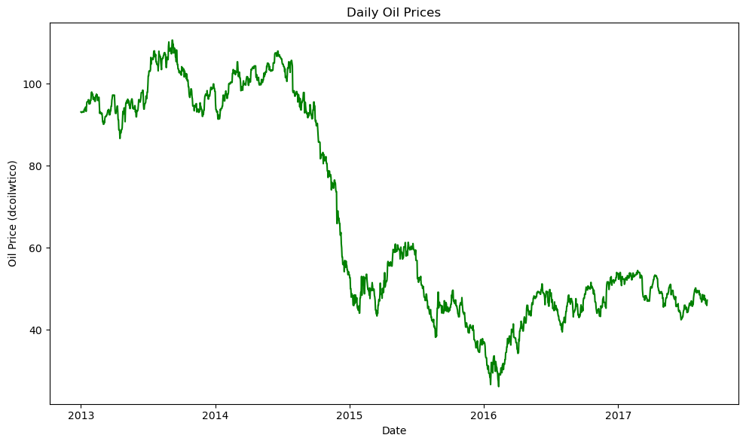

Slide 6
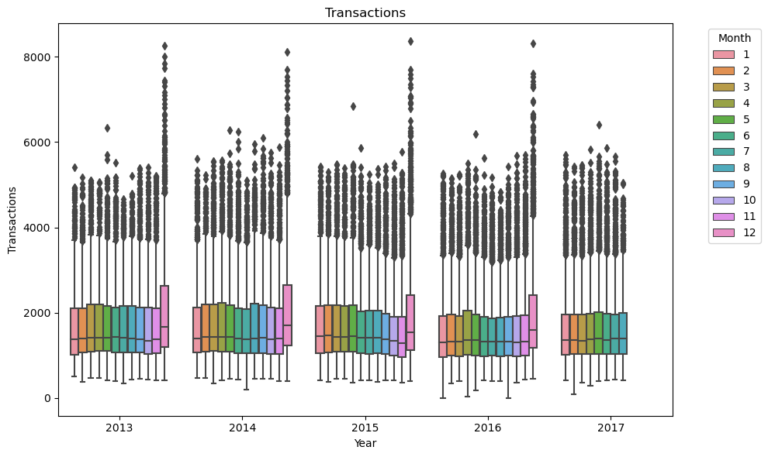
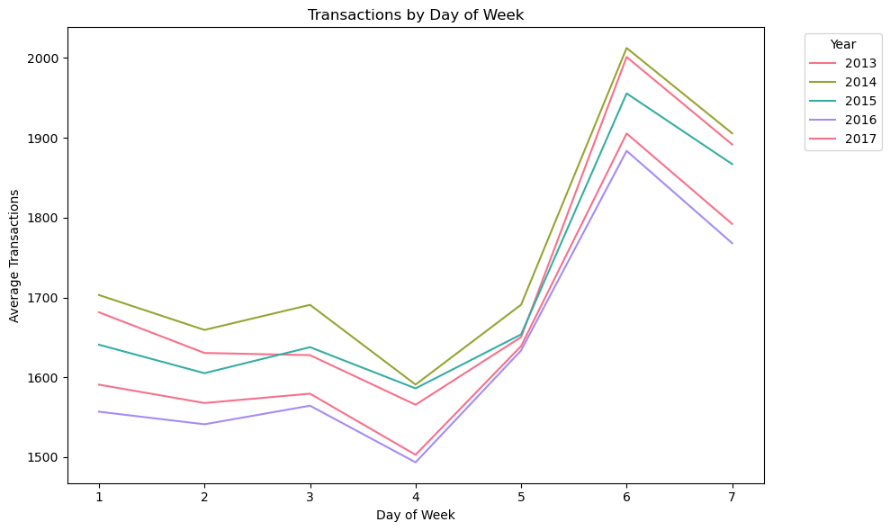

Slide 7
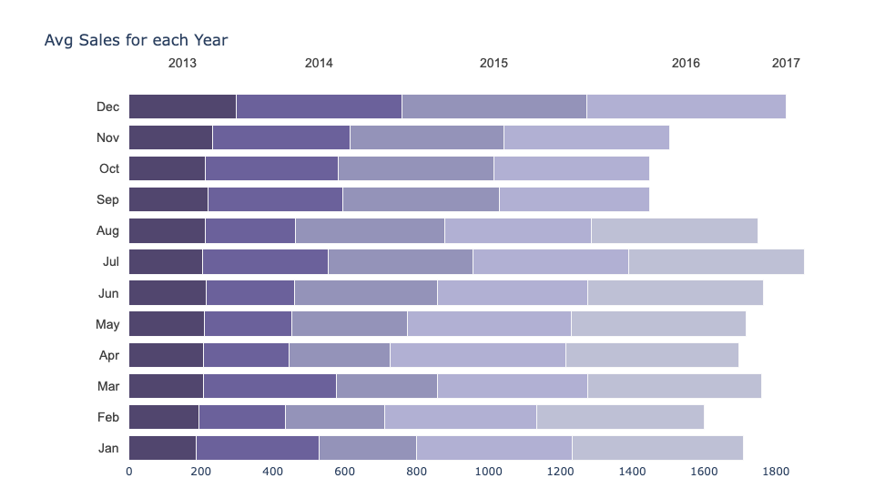
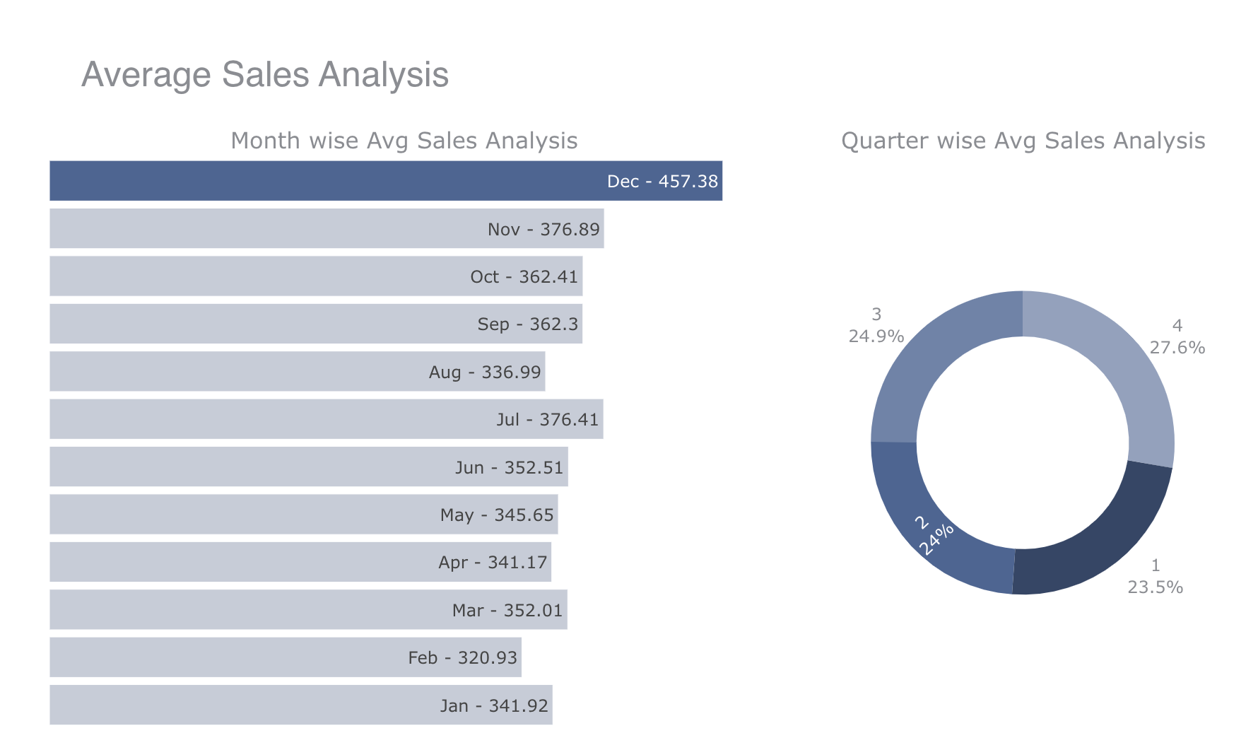

Slide 8
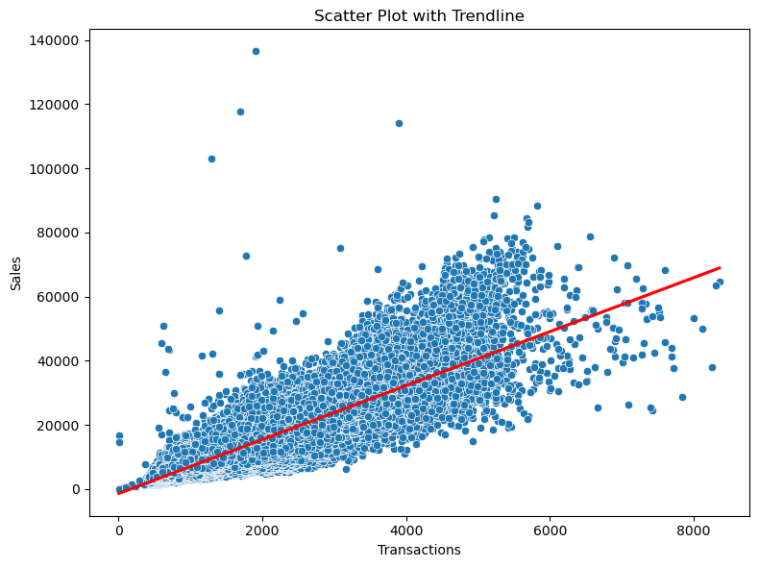

Slide 9
Model Used
RANDOM FOREST :
Our project involves data preprocessing, exploratory data analysis, and model building using a Random Forest Regressor.
Random Forest Regressor is used to build a predictive model for sales. Label encoding is performed on categorical features, and the model is trained on the training set ('train') and tested on the test set ('test’).
Model evaluation is done using Root Mean Squared Log Error (RMSLE) as the evaluation metric, comparing predicted sales with actual sales.

Slide 10
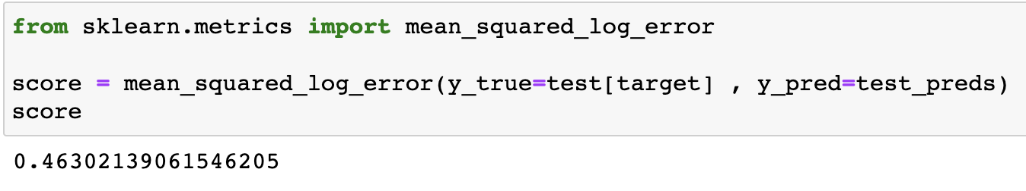
Our Findings
Root Mean Squared Log Error (RMSLE) :
RMSLE without oil price raw feature : 0.5253 RMSLE with oil price as raw feature : 0.650
RMSLE with feature engineered oil price feature ( > 70, <=70) : 0.4630

Slide 11
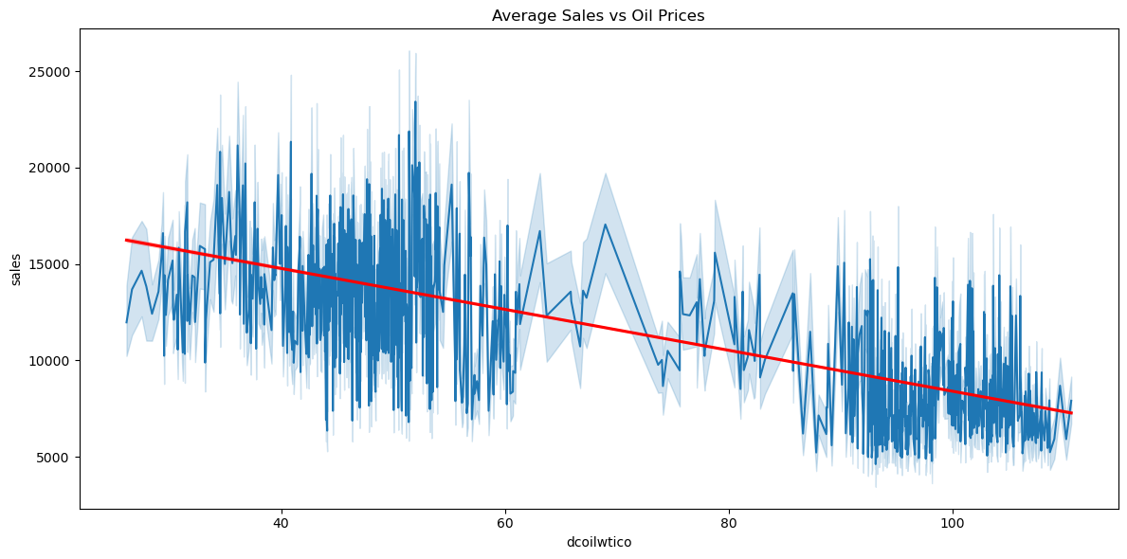

Slide 12
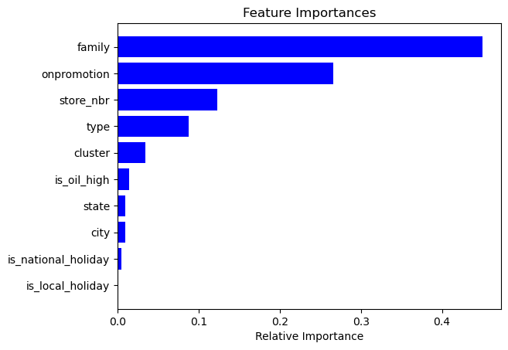
Feature importance is determined using the Random Forest model, and the relative importance of different features is visualized

Slide 13
Challenges
Comprehend Features
Data Prep challenges
Assume Readiness
Adapt to real-world dataset dynamics
ENGAGE

Slide 14
What we learnt
In real-world data analysis, cleaning and handling missing data proved time-consuming.
Surprisingly, data transformations like normalization, standardization had minimal impact on Random Forest model performance.
Using RMSLE helped in getting more accurate reflection of the errors, as it measures the relative differences in the predictions and actual values.

Slide 15
Feel free to share your thoughts or ask any questions you might have?

